Slide 1
WORKING REMOTELY IN A HPC CLUSTER
Fairly share of computing power
JOSE DE VEGA
jose.devega@earlham.ac.uk

Slide 2
HPC = High-performance computing

Slide 3
Fair use: Job Scheduler
Resources
Resources
Time
Time

Slide 4
Loggining in our HPC cluster: ssh
Secure Shell (ssh) is a popular network protocol for secure data communication, remote shell and command execution, and other network services between two computers connected through a secure channel.
Exercise
Open your terminal and run…
1) ssh training01@10.0.49.161
where ssh is the command, training01 is your username, and 10.0.49.161 is the address of the server
2) Run the commands, pwd and who; what is the result?
Note1: If you are in the second row, your username is training02, and so on…
Note2: Your password is earlhamNN, where NN is your row number, eg. earlham02 for the second row.

Slide 5
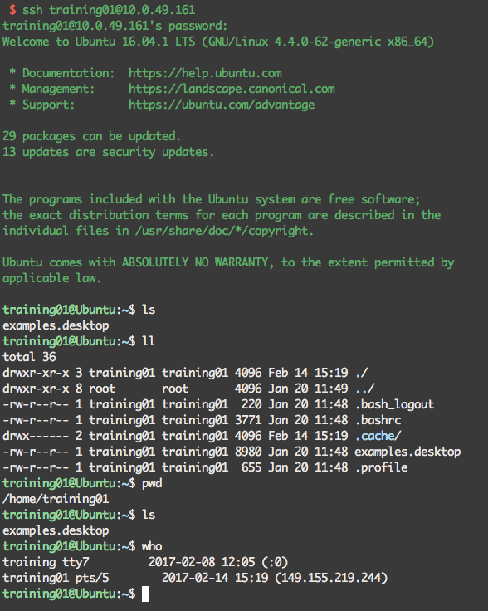
Loggining in our HPC cluster: ssh
Secure Shell (ssh) is a popular network protocol for secure data communication, remote shell and command execution, and other network services between two computers connected through a secure channel.
Exercise
Open your terminal and run…
1) ssh training01@10.0.49.161
where ssh is the command, training01 is your username, and 10.0.49.161 is the address of the server
2) Run the commands, pwd and who; what is the result?
Note1: If you are in the second row, your username is training02, and so on…
Note2: Your password is earlhamNN, where NN is your row number, eg. earlham02 for the second row.

Slide 6
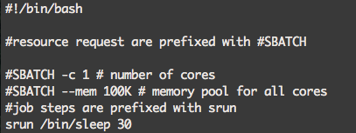

Run a simple job on the cluster
Create a new text file with the test editor nano:
nano josedevega.sh
Copy this example and save it:
Submit it to slurm:
sbatch josedevega.sh
Check how is running:
sbatch training01
Note: replace 01 with your row number
Basic commands:
sbatch yourscriptname.sh
squeue –u yourusername
squeue -a
scancel yourjobid
After checking that is running, try to cancel it:
scancel 4
Where the number is the JOBID of yours, that you can find in the first column of squeue.

Slide 7
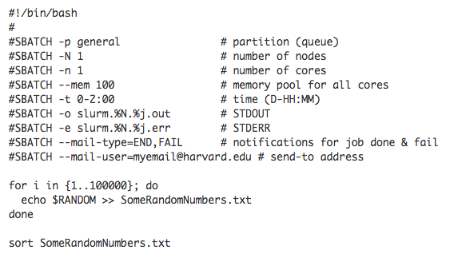
Requesting resources for a new task…
debug
M

